Slide 1
CSCI-351 Data communication and Networks
Lecture 17: BGP + Security (aka RPKI)
Warning: This may be hard to understand. Do not lose yourself during the class and keep asking questions

Slide 2
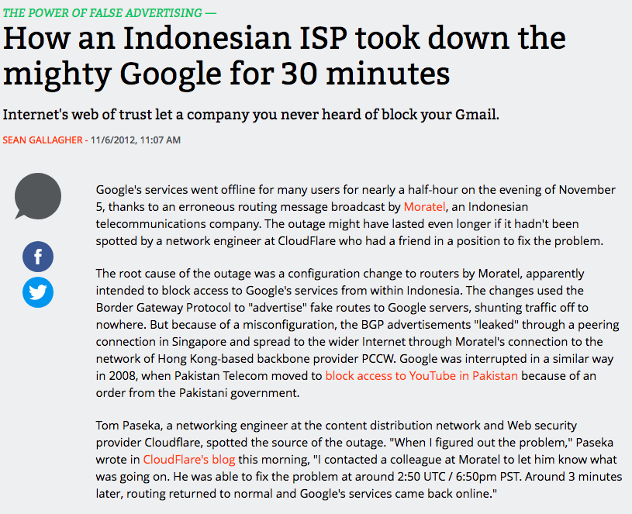

Slide 3
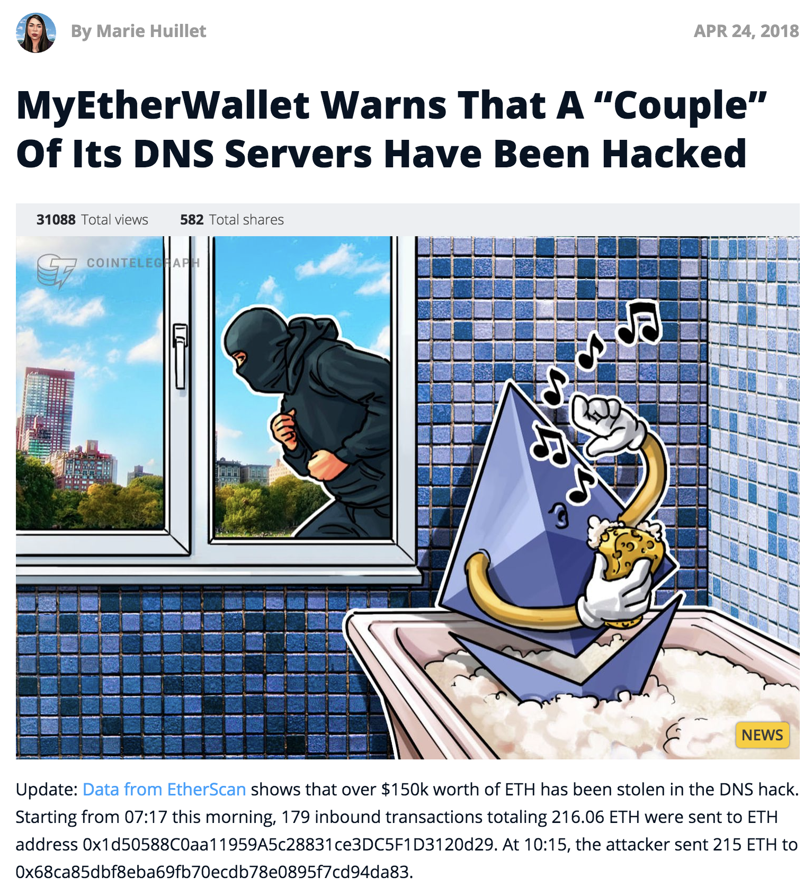

Slide 4
And more..

Slide 5
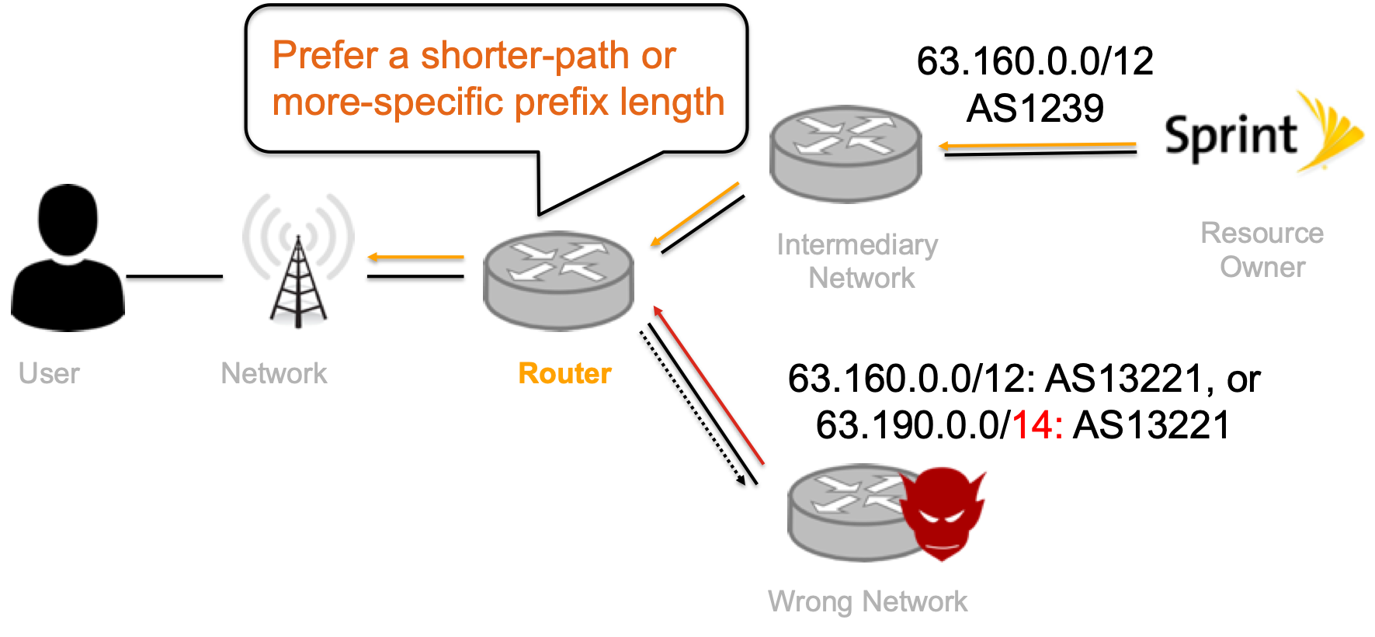
BGP Hijacking: how it works (high-level view)
63.160.0.0/12
AS1239
63.160.0.0/12: AS13221, or
63.190.0.0/14: AS13221

Slide 6
Resource PKI
(Public Key Infrastructure)
Public Key Infrastructure framework designed to secure Internet’s routing structure; specifically BGP (developed starting in 2008)
(Cryptographically verifiable)
Prefix-to-AS Mapping Database
185.34.56.0/22 AS3356
BGP announcement
AS 4385
129.21.128.0/17 AS4385
129.21.0.0/16
…
129.21.0.0/16
1299 3356 4385
…
Owner
…
Router
Prefix
AS-PATH
129.21.0.0/16 AS4385
193.56.235.0/24 AS3549
Notes:
RPKI is a protocol for BGP.
Recall the BGP is a internet routing protocol and it works based on announcement to
build a path to the origin, but there is no security feature builtin, so theoretically anybody participate in BGP protocol can announce google’s IP space;
Due to this issue, there are many secure BGP protocols (I’d say SBGP) introduced and RPKI is the most recent one.
RPKI uses a public key infrastructure to secure Internet’s routing structure
What RPKI ultimately does is to help create a secure and verifiable prefix-to-as mapping database for routers to verify the origin announcing the IP prefixes.
So, if a router receives an BGP announcement containing IP prefix and AS-PATH, it takes IP prefix, prefix length and the origin to see if it is in the mapping table.
If it is matched with an entry in the database, it means that the origin is authorized to announce such BGP announcement so that a router can accept the it.

Slide 7
RPKI: How it works?
What does an resource owner needs to do
to protect their IP prefixes?
BGP announcement
AS 4385
129.21.0.0/16
Router
Owner
How can a router verify it using RPKI?
Notes:
Then, the next question is how this database is created and how it can be validated.
Largely, there are two processes; the first is about the registration process for the network operators to to protect their resources using RPKI and
And the other one is about validation process.

Slide 8
RPKI Structure
{
Certificate
129.21.0.0/16
AS 4385
129.21.0.0/20, AS 4385
129.21.1.0/20, AS 4385
Validated ROA Payload (VRP)
ROA
Route Origin Authorization
129.21.240.0/20, AS 4385
129.21.0.0/16-20, AS 4385
MaxLength
Notes:
If a resource holder wants to create a secure mapping between AS number and IP prefixes that they are going to announce, they first needs to create a certificate.
After that it needs to create another object called ROA;
ROA is the core object of RPKI, which authorizes an AS to announce certain IP prefixes. This ROA is signed by the certificate.
And let’s see what’s in ROA;
Basically, ROA contains the list of IP prefixes that the AS will announce; for example, if the AS 4385 wants to divide its /16 IP prefixes into multiple /20 and wants to announce, then ROA must contain each of the /20 IP prefixes.
So, as a separate entry, AS 4385 should insert each of the entries in ROA; and each of them is called “Validated ROA Payloads” VRPs, which is an actual unit for BGP validation.
However as you can tell, there are lots of entry in a single ROA,
What I can do instead is just to introduce a single entry with an attribute called MaxLength, which basically specifies the maximum prefix length that this single VRP can authorize.
For example by setting the MaxLength attribute with 20, this single VRP can be used to authorize any IP prefixes of which length is between 16 and 20.
As you can tell, The MaxLength attribute is efficient, as it is basically a macro that allows a single ROA to match many sub-prefixes.
However, if those sub-prefixes that are matched by the ROA, are not actually advertised, then it can be vulnerable to forged-origin sub-prefix hijacks, thus, it is often recommended to use MaxLength only if all sub-prefixes will be actually advertised in BGP.
A quick stupid question; to enable RPKI, customer ISP needs to ask it’s provider ISP to get the certificate signed?
But the ROA has to be consistent with actual BGP

Slide 9
RPKI Structure
AFRINIC
ARIN
APNIC
LACNIC
RIPE NCC
Regional Internet Registries
Sign
{
LIRs
(e.g., ISP)
Certificate
Certificate
129.21.0.0/16
AS 4385
129.21.0.0/20, AS 4385
129.21.1.0/20, AS 4385
Validated ROA Payload (VRP)
ROA
Route Origin Authorization
129.21.240.0/20, AS 4385
129.21.0.0/16-20, AS 4385
MaxLength
Notes:
Then, the next question is how can we verify the certificate and ROA.
Actually, Internet resource numbers such as IP addresses and ASNs are allocated and managed by Regional Internet Registries, which means they know who is an owner of IP space (and ASs). Thus, they have a trust anchor and root certificate and sign intermediate certificate such as Local Internet registries certificate.
Thus, each certificate and ROA has to be ultimately signed by its RIR’s trust anchor and uploaded to the responsible repository managed by RIRs. Thus, if you want to use RPKI, you have to download RPKI objects from the repository and create a chain of trust leading up to its RIR and verify each chain.

Slide 10
RPKI: How it works?
What does an resource owner needs to do
to protect their IP prefixes?
BGP announcement
AS 4385
129.21.0.0/16
Router
Owner
How can a router verify BGP announcements using RPKI?
Notes:
Then the next question, how a router use this information to verify the announcement

Slide 11
RPKI: How it works?
Validation process: Valid
Prefix-to-AS Mapping Database
BGP announcement
1.1.0.0/16 AS 111
1.1.0.0/16 AS 111
1.1.0.0/16 AS 111
Router
2.0.0.0/8-16 AS 222
3.3.0.0/16 AS 333
4.4.4.0/24 AS 444

Slide 12
RPKI: How it works?
Validation process: Valid (w/ MaxLength)
Prefix-to-AS Mapping Database
BGP announcement
2.24.0.0/16 AS 222
1.1.0.0/16 AS 111
Router
2.0.0.0/8-16 AS 222
2.0.0.0/8-16 AS 222
3.3.0.0/16 AS 333
4.4.4.0/24 AS 444

Slide 13
RPKI: How it works?
Validation process: Invalid (too-specific)
Prefix-to-AS Mapping Database
BGP announcement
3.3.3.0/24 AS 333
1.1.0.0/16 AS 111
Covered, but the announcement is too specific
Router
2.0.0.0/8-16 AS 222
3.3.0.0/16 AS 333
3.3.0.0/16 AS 333
4.4.4.0/24 AS 444

Slide 14
RPKI: How it works?
Validation process: Invalid (wrong ASN)
Prefix-to-AS Mapping Database
BGP announcement
4.4.4.0/24 AS 555
1.1.0.0/16 AS 111
IP prefix is matched,
but the ASN is different.
Router
2.0.0.0/8-16 AS 222
3.3.0.0/16 AS 333
4.4.4.0/24 AS 444
4.4.4.0/24 AS 444

Slide 15
RPKI: How it works?
Validation process: Unknown (Uncovered)
Prefix-to-AS Mapping Database
BGP announcement
5.5.0.0/16 AS 555
1.1.0.0/16 AS 111
?
Router
Uncovered, thus unknown
2.0.0.0/8-16 AS 222
3.3.0.0/16 AS 333
4.4.4.0/24 AS 555

Slide 16
What RPKI can vs. can’t do
129.21.0.0/16
AS 1123 2234 4456 4385
VRPs: 129.21.0.0/16, AS 4385
AS 4385
BGP announcement
129.21.0.0/16 AS 2231
AS 2231
RPKI attests that the origin AS number is authorized to announce the prefix(es)
Notes:
attests that the origin AS number is authorized to announce the prefix(es)

Slide 17
What RPKI can vs. can’t do
129.21.0.0/16
AS 1123 2234 4456 4385
VRPs: 129.21.0.0/16, AS 4385
AS 4385
BGP announcement
129.21.0.0/16 AS 2231 4385
AS 2231
RPKI does not protect from path-shortening attacks
Notes:
attests that the origin AS number is authorized to announce the prefix(es)

Slide 18
What RPKI can vs. can’t do
VRPs: 129.21.0.0/16, AS 4385
BGP announcement
129.21.0.0/16, AS 4385
AS 4385
BGP announcement
129.21.0.0/16 AS 2231 4385
AS 2231
RPKI does not provide “Path” validation
Notes:
attests that the origin AS number is authorized to announce the prefix(es)

Slide 19
What RPKI can vs. can’t do
VRPs: 129.21.0.0/16, AS 4385
BGP announcement
129.21.0.0/16, AS 4385
AS 4385
BGP announcement
129.21.240.0/20, AS 2231 4385
AS 2231
RPKI can protect from sub-prefix hijacking
Notes:
attests that the origin AS number is authorized to announce the prefix(es)

Slide 20
RPKI: How it works?
Validation Process
There is a VRP that “covers” IP prefix
?
The ASN of the VRP and the ASN in the BGP are identical?
There is a VRP that matches IP prefix
(using MaxLength, if exists)
Notes:
In summary,
Validation process works this way.
If we couldn’t find any single VRP that covers announced IP prefix, then we say it is unknown.
But If we find the VRP’s AS number is different, then it is invalid,
We found the ASNs are identical, but If we fail to find VRPs that exactly match the IP prefix, then it becomes invalid.
If we found VRPs that satisfy all condition then the BGP announcement becomes valid.

Slide 21
Why do we study RPKI?
It is relatively new
It works differently
It is easy to deploy
Notes:
RPKI is different than other PKI
It is very new: Webpki introduced 30 years ago, dnssec 20 years ago, rpki was 9 years ago
(2) More importantly, it works differently.
For example, webpki gives you all chains of the certificate, let you verify them
DNSSEC, gives you domain name, signature, dnskey, ds record.
But if you want to validate a bgp announcement, you have to fetch all rpki objects from repositories and make a chain to validate them and extract vrps, which is a out-of-band mechanism, leaving a couple of trade off and we want to see how these differences impact on the deployment.
(3) secure routing perspective, there have been many BGP security protocols introduced such as BGPSEC and other SBGP, which are not deployed very well. However, RPKI is much easier to deploy, you don’t need to throw out your existing routers.
Thus, even though some predicted that “it is never going to be deployed like DNSSEC”, but we want to see if that is true.
So in this presentation, I want to talk if RPKI is ready for the big screen.
And as you know, many PKI protocols do not work as expected, so we want to know why we see invalid BGP announcements.

Slide 22
Datasets (1)
RPKI Objects
 | Measurement Period* | VRPs (from the latest snapshot)
 |  | Number | Percent of ASes
APNIC | 2011-01 ~ 2019-02 | 14,025 | 8.14%
LACNIC | 2011-01 ~ 2019-02 | 4,510 | 9.33%
RIPENCC | 2011-01 ~ 2019-02 | 40,830 | 16.04%
ARIN | 2012-09 ~ 2019-02 | 4,575 | 1.47%
AFRINIC | 2011-01 ~ 2019-02 | 176 | 3.30%
*https://ftp.ripe.net/rpki
Notes:
To answer those questions, we need two datasets.
The first one is historical RPKI objects to see how much of IP prefixes are covered by RPKI; Thanks to RIPE NCC, we obtained daily snapshots of each of the RPKI repositories since its adoption. we are grateful to RIPE NCC for making this data available for analysis.
And from the the latest snapshot, we observe that overall RPKI deployment rate is up to 16

Slide 23
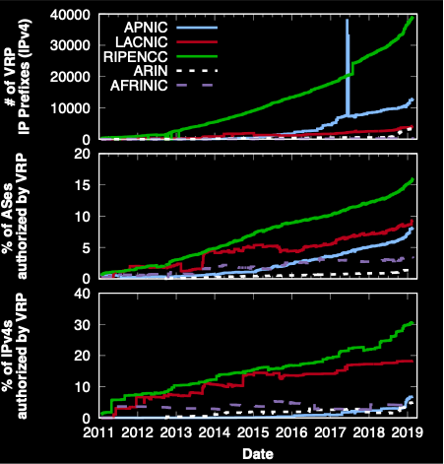
Deployment:
VRPs
A general increasing trend in adoption of RPKI!
It varies significantly between RIRs:
1.38% (ARIN) ~ 15.11% (RIPENCC) of ASes and
2.7% (AFRINIC) ~ 30.6% (RIPENCC) of IPv4 addressesare authorized by VRPs
* AS4775, AS10091, AS9299
Notes:
If we see the growth of adoption, it’s more interesting;
These graphs show (1) # of VRPs (2) % of ASes and (3) % of IPv4 spaces authorized by VRP,
As you can see, the adoption rate has been increasing, especially if you focus on 2019, you can see very rapid growth.
For example, the fraction of the total IP space of RIPENCC covered by VRPs rose from 19.2% to 30.6% between January 1, 2017 and February 27, 2019
This is very encouraging, because one previous work in 2016, showed that 84% of network practitioners were not interested in deploying RPKI.

Slide 24
Datasets (2)
BGP Announcements
 | Measurement Period | # of
 |  | VPs | Prefixes
RIPE-RIS | 2011-01 ~ 2018-12 | 24 | 905K
RouteViews | 2011-01 ~ 2018-12 | 23 | 958K
Akamai | 2017-01 ~ 2018-12 | 3,300 | 1.94M
More than 46 Billion BGP announcements
Notes:
The next question is.. how many I P prefixes being announced are actually covered by RPKI
To answer that, we also need BGP announcements dataset as well.
We used two public datasets from RIPE and RouteViews; We also leveraged Akamai’s network to obtain BGP announcements from thousands of vantage points globally.

Slide 25
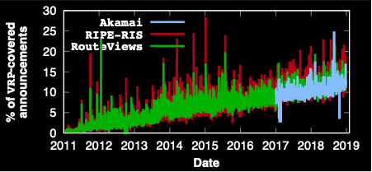
Deployment:
BGP announcements w/ RPKI
Deployment
RPKI-enabled BGP announcements are consistently increasing
Notes:
Now, Y axis shows the percentage of BGP announcements of which IP prefixes are covered by at least one VRP.
As you can tell, As the RPKI objects grows, we also observe that BGP announcements that are actually covered by RPKI is also growing.
A key observation is that this percentage is consistently increasing across all datasets: between 9.98% and 11.28% of BGP announcements are covered by VRPs in our latest snapshot.

Slide 26
RPKI validation over
BGP announcements
?
43 B (91.9%)
(unknown)
3.5 B (90.4%)
BGP
ann.
BGP
ann.
344 M (9.6%)
46.8 B
3.8 B (8.1%)
Covered
Notes:
Now, let’s see how much of them are actually unknown (which means we can’t validate), valid, and invalid.
From a total of 46 B announcements for 8 years, we found that only 8.1% are covered, but good news is that 90% of them are valid.
But some of you may think that 10% is still huge. So let’s see if this BGP qualify has been improved or not

Slide 27
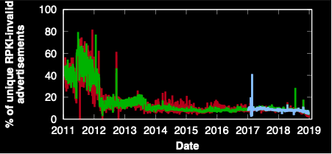
RPKI validation over
BGP announcements
During 2011, 48.92% covered announcements were invalid; 27.47% of invalid were due to announced IP prefixes being covered, but not matched with VRPs
?
43 B (91.9%)
(Not covered)
3.5 B (90.4%)
BGP
ann.
BGP
ann.
344 M (9.6%)
46.8 B
3.8 B (8.1%)
Only 2~4%
Notes:
So Y axis shows the percentage of RPKI-invalid advertisements
As you can see, for the first year of RPKI adoption was a mayhem; about half of covered announcements were invalid but it gets somehow settled down in 2012 and has been much better.
We believe the sharp decrease in 2012 are due to the RIRs who improved their hosted services and RPKI training. For example, the RIPE NCC interface started to show BGP announcement validity to prefix owners and offered the option to operators to receive alerts about invalid announcements. The interfaces of LACNIC and APNIC were similarly modified to show invalid announcements to their users more clearly.
Finally at the end of our snapshot we find that only 2~4% of covered prefixes are invalid.

Slide 28
Then, why are they invalid?
There is a VRP that “covers” IP prefix
?
The ASN of the VRP and the ASN in the BGP are identical?
There is a VRP that matches IP prefix
(using MaxLength, if exists)
Notes:
As you know, we validated BGP announcement through this process.
And let’s think why and how these two things could happen

Slide 29
Why Invalid?
129.21.0.0/16, AS 4385
VRP1
Too specific
Wrong ASN
129.21.240.0/20, AS 4385
129.21.0.0/16, AS 1334
BGP
BGP
Potential Reasons:
Misunderstanding of ROAs (VRPs) of network operators*
Stale ROAs
…
Potential Reasons:
Malicious hijacking attacks?
* Y. Gilad, O. Sagga, and S. Goldberg. MaxLength Considered Harmful to the RPKI. CoNEXT, 2017.
Notes:
Now, let’s focus why they are invalid; overall there are two reasons why a BGP announce goes invalid.
First reason is that the announced IP prefix is too specific; In other words, the IP prefix is covered by at least one VRP, and the origin in the announcement is identical to the VRP ASN, but no VRP matches the announced IP prefix.
In such a case, it is likely due to misconfigurations rather than malicious attempts
There is a study showing that some network administrators were confused regarding the MaxLength attribute; for example, network administrators would incorrectly assume that the prefix length specified in the ROA would validate all IP prefixes that are more specific.
The other reason is simply the ASN is not matched with the one in VRP.
* But it is not all..
There are many potential reasons for this; for example, some ISP manages multiple AS number and swap the IP spaces with each other but forgot to update ROAs,
Or some provider AS registered ROA, but leased some of the IP spaces to the customers and not updating it.
Or some ASes offer DDoS prevention service and announcing IP prefixes on behalf of origin AS,
And some of the others can be malicious, but of course we don’t know for sure.

Slide 30
Then, why are they invalid?
There is a VRP that “covers” IP prefix
?
The ASN of the VRP and the ASN in the BGP are identical?
Potential Reasons:
Malicious hijacking attacks?
Wrong ASN
There is a VRP that matches IP prefix
(using MaxLength, if exists)
Potential Reasons:
Misunderstanding of ROAs (VRPs) of network operators*
Stale ROAs
…
Too-specific
* Y. Gilad, O. Sagga, and S. Goldberg. MaxLength Considered Harmful to the RPKI. CoNEXT, 2017.
Notes:
unknown, invalid, valid
It could be malicious, of course we don’t know for sure.
I’m going to discuss about it later,
And if we found vrps that share the same ASNs, but fail to find a VRPs that exactly matches the announced IP prefix, then it could be due to some misconfigurations.
Such as a single VRP can validate all sub prefixes more specific than the IP prefix length is VRP.

Slide 31
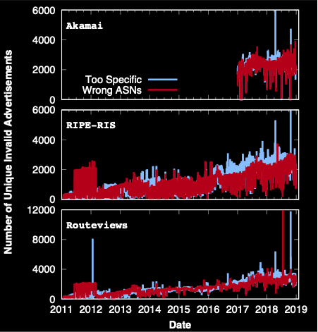
Too specific vs. Wrong ASNs
Notes:
Now, let’s see how much of them are too-specific and wrong-ASNs;
Interestingly, they are nearly equally distributed; 48.0% ∼ 51.5% of the invalid announcements are too-specific
Let’s first focus on Too-specific;

Slide 32
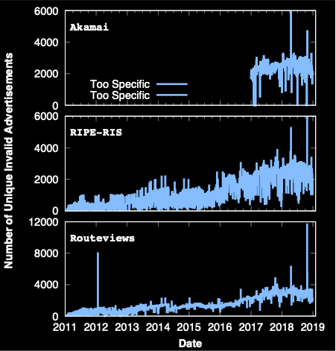
Too specific vs. Wrong ASNs
AS 5089 (Virgin Media Limited)
On April 16, 2018,
3,200 IP prefixes are more specific than the VRPs; none of them specified MaxLength
AS12322 (Free SAS)
6 ROAs for 7,671 (96.0%) IP prefixes are more specific than the VRPs (w/o MaxLength)
8,800 IP prefixes went invalid failing to specify a proper value for MaxLength
January 22, 2012
Added the MaxLength to include
more specific IP prefixes
January 21, 2012
October 23, 2018
Notes:
Interestingly, we observe many spikes over the datasets;
For example, Virgin Media Limited announced 3,200 IP prefixes but they were too specific as their VRPs are without MaxLength.
Another interesting example is Free SaS;
They announced 7000 too specific IP prefixes and their covered VRPs do not have the MaxLength,
The next day, they published ROA with MaxLength so the issues were gone.

Slide 33
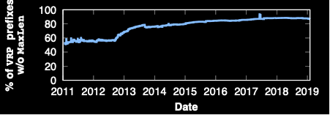
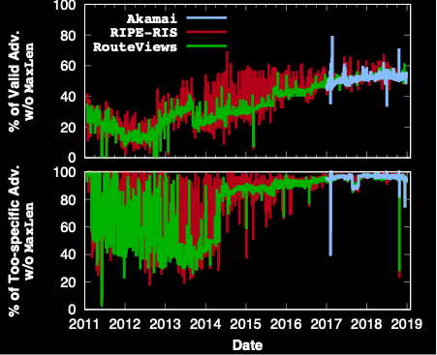
Too-specific and MaxLength attribute
The use of MaxLength has been decreasing
52.3% of the valid IP prefixes are validated
through VRPs with the MaxLength attribute
92% of too-specific announcements are due to VRPs that do not have the MaxLength attribute
Notes:
As you can tell, MaxLength is really powerful tool as it can easily validate many subprefixes that you announce if being used correctly.
Let’s first see the IP prefixes from VRPs that do not contain the MaxLength attribute from all VRP. Interestingly, the usage of MaxLength has been decreasing and only 11.2% of IP prefixes in VRPs use it in our latest snapshot
Then how about the actual ip prefixes being announced through BGP?
So, the graph in the middle shows the % of Valid BGP advertisement validated through VRPs without MaxLength. As you can tell, even though the usage is decreasing, we still see that 52.3% of the valid IP prefixes are validated through VRPs with the MaxLength attribute.
However, when we focus on these too specific advertisement, we see very different thing; more than 90% of the too-specific announcements (and more than 92% in our latest snapshot) are due to VRPs that do not have the MaxLength attribute.
In other words, the majority of the too-specific announcements potentially could have been validated if their VRPs were to correctly set the MaxLength attribute or create explicit VRPs for all the more specifics.

Slide 34
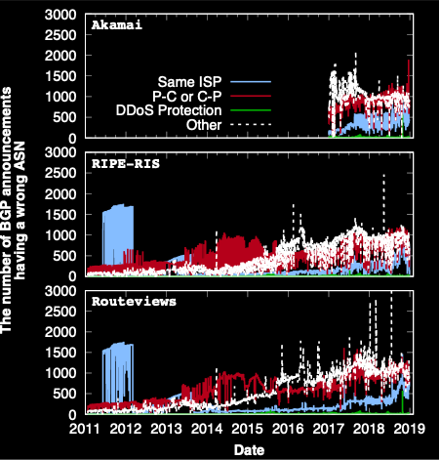
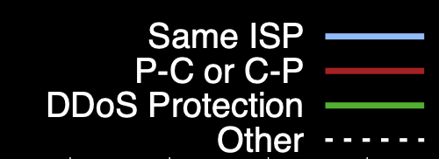
Wrong ASN
Same ISP | Two different ASNs are managed by the same operator
Provider—Customer Relationship | An AS can sub-allocate part of its IP prefixes to its customer
DDoS Protection | Origin ASes may outsource “scrubbing” of their traffic by using traffic diversion to a DDoS protection service (DPS)
Other | We don’t know, but it could be malicious (e.g., hijacking)
Notes:
Now, let’s see the other invalid reasons; which is Wrong ASN.
You might think that all BGP announcements that are originated from wrong ASN are hijack attempts, but actually they might be due to some misconfigurations

Slide 35
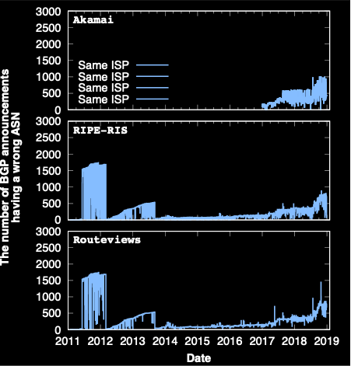
Wrong ASN:
Same ISP
Same ISP | Two different ASNs are managed by the same operator
Provider—Customer Relationship | An AS can sub-allocate part of its IP prefixes to its customer
DDoS Protection | Origin ASes may outsource “scrubbing” of their traffic by using traffic diversion to a DDoS protection service (DPS)
Other | We don’t know, but it could be malicious (e.g., hijacking)
Telmex Columbia S.A. manages two ASes (AS 10620, 14080)
AS 10620 announced 1,500 prefixes supposed to be from AS 14080 for 9 months
Notes:
First,
Couple of ISPs that announcing invalid bop due to misconfiguration

Slide 36
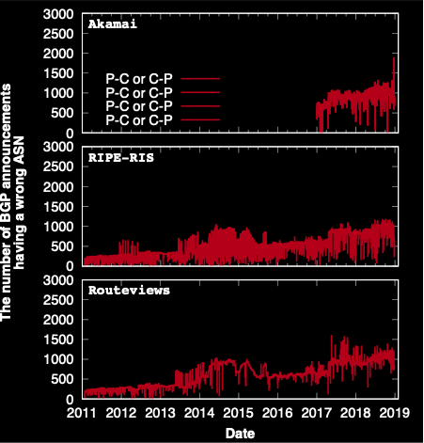
Wrong ASN:
Provider — Customer Relationship
Same ISP | Two different ASNs are managed by the same operator
Provider—Customer Relationship | An AS can sub-allocate part of its IP prefixes to its customer
DDoS Protection | Origin ASes may outsource “scrubbing” of their traffic by using traffic diversion to a DDoS protection service (DPS)
Other | We don’t know, but it could be malicious (e.g., hijacking)
P-C and C-P are quite prevalent; mainly due to providers that have not updated after leasing to the IP prefixes customers (up to 89.45%) such as AS 6128 (CableVision Systems) allocating to 9 different ASes
Notes:
Now, let’s see the other invalid reasons; which is Wrong ASN.
Increasing

Slide 37
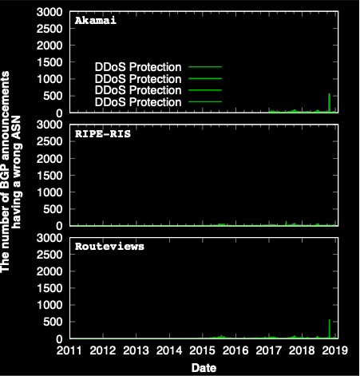
Wrong ASN:
DDoS Protection
Same ISP | Two different ASNs are managed by the same operator
Provider—Customer Relationship | An AS can sub-allocate part of its IP prefixes to its customer
DDoS Protection | Origin ASes may outsource “scrubbing” of their traffic by using traffic diversion to a DDoS protection service (DPS)
Other | We don’t know, but it could be malicious (e.g., hijacking)
We rarely see announcements from DDoS protection services
AS 26415 (Verisign) announced 6 IP prefixes of AS 13285 (TalkTalk)
AS 19905 (Neustar) announced 1 IP prefix of AS 21599
Notes:
We haven’t found that many DDoS protection ASes announcing BGP prefixes on behalf the origin.

Slide 38
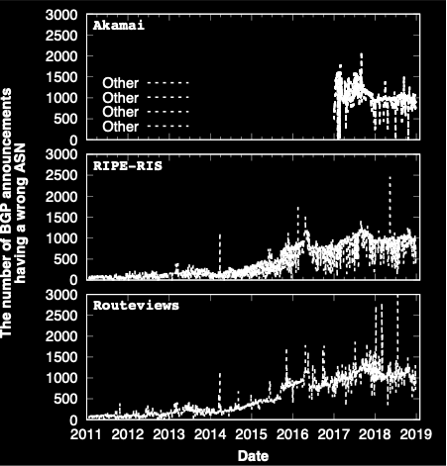
Wrong ASNs:
The others (possibly suspicious)
(1) AS 37468 (Angola Cables) announced more than 2,500 IP prefixes owned by 82 ASes on May 11, 2018 and 15,000 IP prefixes owned by 1,554 ASes on July 19, 2018
(2) Targeted attack: AS 55649 (a private ISP in Hong Kong) announced 1,091 IP prefixes owned by 12 ASes, 10 of which are in China on February 28, 2018
(3) Targeted attack: 401 IP prefixes owned by AS 27738 (Ecuadortelecom S.A.) are announced by 743 ASes on January 7, 2018?
Notes:
The last one is about others.
As these unknown announcements originate from an origin which has likely nothing to do with the authorized origin it could be suspicious.
Of course we don’t know for sure if they are really a hijacking attempt or not, but at least we can’t find any reasons of why this has happened.
As you might expect, we can see many spikes over the graph, which seems very suspicious.
So I’m going to talk about it later but we released all the datasets and the list of these BGP announcement, so if you have any good method to detect hijacking

Slide 39
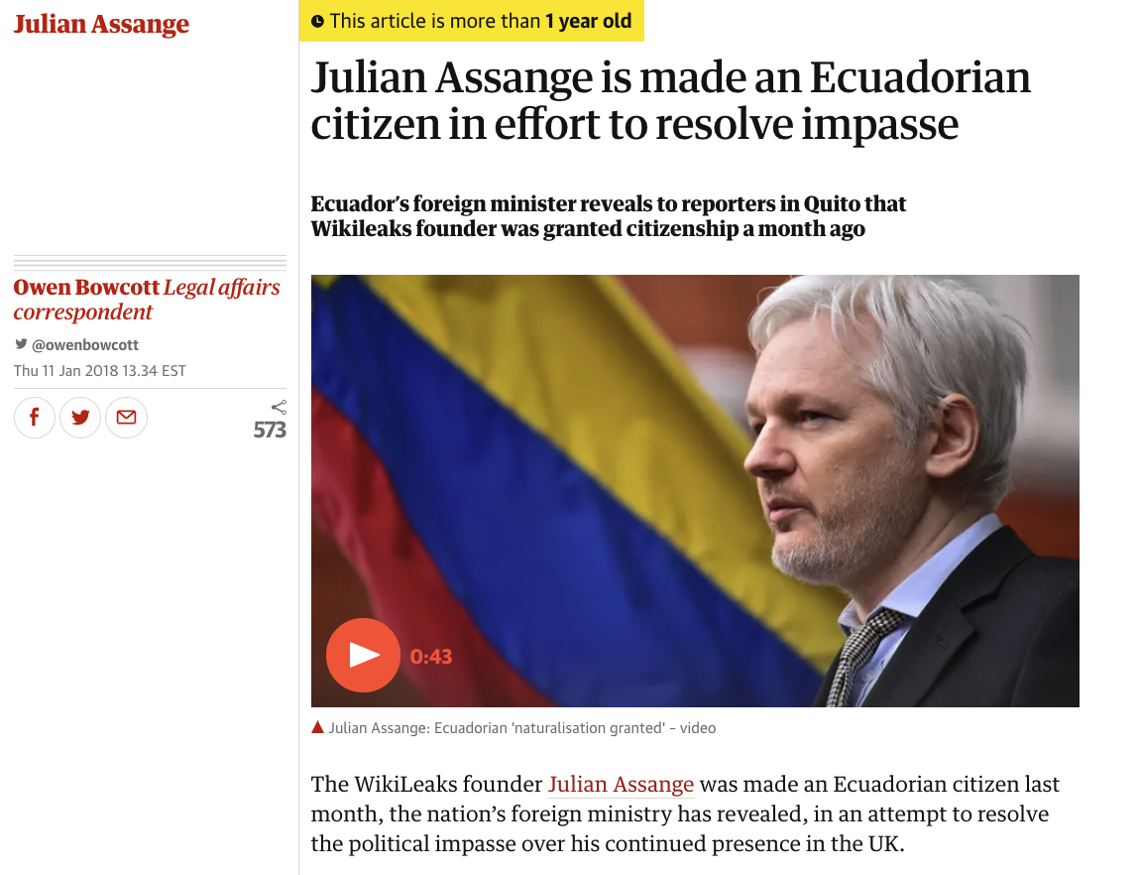
Notes:
There were news that Julian Assange, the founder of Wikileaks, was granted Ecuadorian Citizenship a month prior.

Slide 40
Case-study: BGPStream
2,082 IP prefixes
are unknown to RPKI
6 (2.15%) in the same ISP
Hijack Reports from BGPStream
10 (3.58%) provider and customer relationship
RPKI validation
0 DDoS Protection ASes
2,361 IPv4 Reports
279 IP prefixes are covered by
at least one VRPs
263 (94.27%) are in our “unknown” category
Notes:
Next, we wanted to compare these suspicious announcements with well-known hijacking incidents.
So we used BGPStream’s public reports;
For cross-validation purposes, we downloaded the reports from its Twitter account and validated them using RPKI.
These results show a potential impact of RPKI when it is deployed correctly without misconfigurations; the few misconfigurations can be easily patched by publishing correct ROAs.
The remaining hijack reports are at least suspicious and can be effectively filtered by relying on RPKI validation.

Slide 41
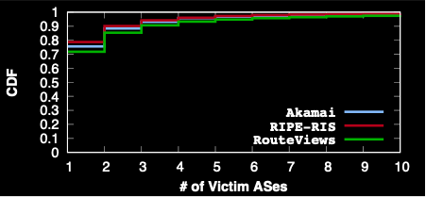
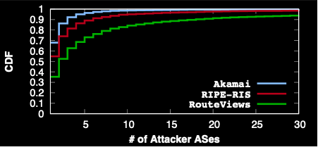
Attacking vs. Victim AS
Notes:
AS 395561 (Absolute Connection) announced 11,512 prefixes owned by 701 ASes (in the Akamai dataset),
AS 200759 (Innofield) announced 362 prefixes owned by 76 ASes (in the RIPE-RIS dataset),
AS 37468 (Angola Cable) announced 15,364 prefixes owned by 841 ASes.

Slide 42
Conclusion and Discussion
RPKI has been widely deployed
RPKI Objects: 2.7% (AFRINIC) ~ 30.6% (RIPENCC) of the total IPv4 space is covered
BGP announcements: 8.1% of BGP announcements are covered
2~4 % of (verifiable) BGP announcements are invalid!
Too specific announcements
Wrong ASNs
Open Question: how can we identify hijacking attempt with high confidence?

Slide 43
Deployment:
VRPs
MaxLength
Disabled
A general increasing trend in adoption of RPKI
It varies significantly between RIRs:
1.38% (ARIN) ~ 15.11% (RIPENCC) of ASes and
2.7% (AFRINIC) ~ 30.6% (RIPENCC) of IPv4 addresses
are authorized by VRPs
ROAs with MaxLength attributes were disabled and those VRPs were separately introduced without MaxLength (June 6th), but rolled back on June 19th, 2017
Notes:
If we see the growth of adoption, it’s more interesting;
These graphs show (1) # of VRPs (2) % of ASes and (3) % of IPv4 spaces authorized by VRP,
As you can see, the adoption rate has been increasing, especially if you focus on 2019, you can see very rapid growth.
For example, the fraction of the total IP space of RIPENCC covered by VRPs rose from 19.2% to 30.6% between January 1, 2017 and February 27, 2019
This is very encouraging, because one previous work in 2016, showed that 84% of network practitioners were not interested in deploying RPKI.
We also found there is a spike at the # of VRPs managed by APNIC near June 2017; this was caused by the introduction of a new management system at APNIC that unified management of RPKI and IRR. This system mistakenly started disabling all of the MaxLength attributes but introducing ROAs separately when existing data was imported into the system upon launch.
When APNIC noticed the sharp increase in ROAs, they rolled backed this change and reintroduced ROAs with MaxLength attributes on June 19th, 2017,
This is why % of ASes and IPv4 spaces remained same even though the number of VRPs were increased very rapidly.

Slide 44
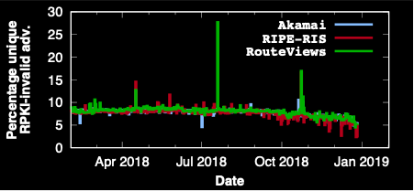
RPKI validation over
BGP announcements
Quality of BGP announcements
Overall percentage of invalid prefixes has been decreasing rapidly
Notes:
Actually, it gets even better by showing only 2~4% of verifiable prefixes are invalid.
We believe this is due to recent efforts from IXPs who adopted RPKI as a service.
Some networks started to drop RPKI invalids either by using this service or by deploying RPKI validation themselves; for example, DE-CIX deployed RPKI and started to drop RPKI invalid prefixes in 2019

Slide 45
Why Covering is not valid?
VRPs: 129.21.0.0/16, AS 4385
BGP announcement
129.21.0.0/16, AS 4385
AS 4385
BGP announcement
129.21.240.0/20, AS 2231 4385
AS 2231

Slide 46
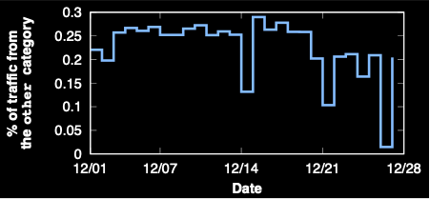
Traffic from the “other” category
Amount of
Traffic
The portion of all HTTP/S traffic coming from the other category is very small (less than 0.3%)
Notes:
The last analysis is about traffic;
We wanted to estimate the amount of traffic from the “other” category, which might be helpful for network operators to estimate the impact of dropping potentially suspicious prefixes using the RPKI.
if it is too high, then the network operators may be reluctant to drop such suspicious prefixes.
In collaboration with Akamai Technologies, we calculated the portion of all HTTP/HTTPs traffic that came from the IP prefixes in “other” category between December 1st and December 28th,
We find that a very small fraction of traffic (less than 0.3%) was exchanged with the “other” prefixex; however, we also note that this is a non-negligible amount of traffic and that we cannot prove that the invalid announcements are hijack attempts so it could be a little bit hasty decision to drop such prefixes.
So There remains a need for reliable techniques for detecting hijacking attempts, so that this information can be used in concert with RPKI validation to safely drop unauthorized prefix announcements and their traffic.

Slide 47
How a Router Uses RPKI
AFRINIC
LACNIC
APNIC
ARIN
RIPE NCC
RPKI-RTR Protocol
Router
Validator
Routinator (NLNetLabs)
OctoRPKI (Cloudflare)
RPKI Validator (RIPE NCC)
…
Notes:
As you can tell, this validation process is a bit complex, so these validation processes are done by validator.
What it does is to scrape all the RPKI objects in the repositories and after that create a chain of trust for each of the rpki objects and validate them.
And router can use RPKI-RTR protocol just to fetch the list of VRPs.
Currently there are a number of RPKI validator tools, for example Routinator from NLNetLabs, and OctoRPKI …

Slide 48
ROV (Route Origin Validation)
A route prefix is “covered”
An IP prefix is covered | The IP prefix address and VRP IP prefix address are identical for all bits specified by the VRP IP prefix length
129.21.0.0/16, AS 4385
BGP
Covers?
129.21.0.0/12, AS 4385
VRP1*
129.21.0.0/16, AS 3838
VRP2
129.21.0.0/8-16, AS 4385
VRP3
129.21.240.0/20, AS 4385
VRP4
* Validated ROA Payloads
Notes:
Verifying process is straightforward, but I have to introduce two terminologies; cover and match.
An announced IP prefix is called “Covered” when the IP prefix address and VRP IP prefix address are identical for all bits specified by the VRP IP prefix length.
So as you can tell if a VRP’s IP prefix can cover the BGP then, it’s called covered.
So let me give you a couple of examples.
Let’s say that we received a BGP announcements for this IP prefix with origin AS number.
And if we only have this VRP in the ROA, we can say that the IP prefix in the BGP announcement is covered by a VRP.
Let me give you another example,
For this VRP, the VRP and BGP IP prefixes are basically same, so the IP prefix is covered by the VRP; even though the ASN is different, for here, what we are only interested in is actually IP prefix, so we don’t care about the mismatch here.
Third example,
As you can tell VRP now covers the BGP.
But, for the last VRP, it is more specific than the BGP, so it is not covered.

Slide 49
ROV (Route Origin Validation)
A route prefix is “matched”
An IP prefix is matched | 1. VRP IP prefix covers the announced IP prefix 2. VRP’s ASN == Announced ASN 3. Announced IP prefix length <= VRP’s IP prefix length (including MaxLength)
129.21.0.0/16, AS 4385
BGP
Covers?
Matches?
129.21.0.0/12, AS 4385
VRP1*
129.21.0.0/16, AS 3838
VRP2
129.21.0.0/8-16, AS 4385
VRP3
129.21.240.0/20, AS 4385
VRP4
* Validated ROA Payloads
Notes:
The next terminology is “match”
The match condition looks more complicated than “cover”, but it is not actually.
We say the IP prefix matches with a VRP if the IP prefix in VRP covers the announced IP prefix, and identical ASN, and announced IP prefix length is less than or equal to the maxlength.
So basically, if VRP does not have MaxLength attribute, the VRP’s IP Prefix has to be identical to the announced IP prefix.
So, let’s see the example again.
For the first VRP, it does not satisfy the third condition, so it’s not mached.
For the second VRP, two IP prefixes are identical, but ASN are different, so it is not matched.
For the third one, if there were not maxlength attribute, it would just cover the announced IP prefix, but as there are MaxLength attribute, the announced prefix can satisfy the third condition, thus it is regarded as a match.
For the last one, it does not match anyway.
So, now we are now ready to verify the the announced IP prefix.

Slide 50
ROV (Route Origin Validation)
Validation
?
Unknown | No VRP Covers the Route Prefix
Valid | At least one VRP Matches the Route Prefix.
Invalid | At least one VRP Covers the Route Prefix, but no VRP Matches it.
129.21.0.0/16, AS 4385
BGP
Covers?
Matches?
Status
129.21.0.0/12, AS 4385
VRP1
129.21.0.0/16, AS 3838
VRP2
129.21.0.0/8-16, AS 4385
VRP3
129.21.240.0/20, AS 4385
?
VRP3
Notes:
So based on the results of “cover” and “match”, we can finally decide whether the announcement is valid or invalid, or unknown.

Slide 51
% of VRP-covered announcements:
IPv4 vs. IPv6

